Slide 1
Formation of electrical double layer
Fyodor Malchik

Slide 2
The real situation is more complicated as a large
number of ions will be dissociated from each surface
This generates a high electric field and a stronger
attraction between the surface and the dissociated
ions. Additionally, the solvated ions repel each other.
In fact the dissociated ions do not leave the surface
region completely.
They form a “diffuse double layer”.

Slide 3
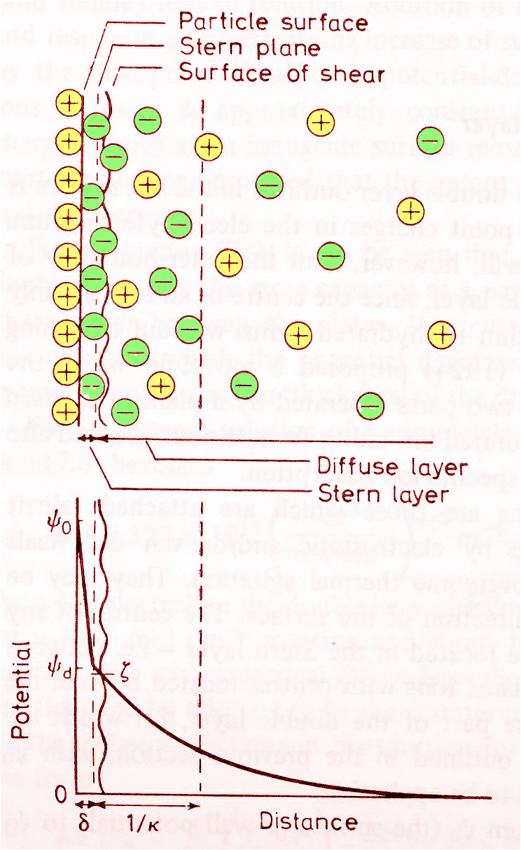
Quantitative treatment of the electrical double layer is an extremely difficult problem. In order to treat the problem we make use of several assumptions and simplifications. Let us examine the case of an infinite, flat, charged planar surface. x is the distance normal to the surface.
see Hunter, R Foundations of Colloid Science I & II, Oxford, 1989

Slide 4
Quantitative treatment of the electrical double layer is
an extremely difficult problem. In order to treat the problem
we make use of several assumptions and simplifications.
x
Let us examine the case of an infinite, flat, charged planar
surface. x is the distance normal to the surface.

Slide 5
Ψ
0
Ψ
(
x)
Ψ₀ is the electric potential at the surface and Ψ_{(x)} is the electric potential at a distance x from the surface

Slide 6
For a planar interface the potential is related to the charge density by Poisson’s equation
(1)
Where ρx is the net charge density in Cm⁻³ at distance x (ions per unit volume is equivalent to charge per unit volume).

Slide 7
In order to describe the decay of the potential from the surface we would like to determine ρx. The density (or population per unit volume) of any ion of charge Z_{i}q must depend on it’s potential energy at that position. (Note Z is the valency). The potential energy is by definition given by Z_{i}qΨ(x).
Note that q is the positive value of the electron charge, or the charge on a proton. Since any ion next to a charged surface must be in equilibrium with the corresponding ions in the bulk solution, it follows that the electrochemical potential of an ion at distance x from the surface must be equal to its bulk value. Thus:

Slide 8
where C_{i}(B) and C_{i}(x) are the ion concentrations in bulk and at distance x from the charged surface, and it is assumed that these are dilute solutions (ie ψ(B) = 0). This equation leads directly to the Boltzmann distribution, which can be used to obtain the concentration at any other electrostatic potential energy by the familiar relationship:
In bulk solution we define the concentration of ion i as ρ_{i}(bulk).
We would expect a Boltzmann distribution of ions determined
by the ratio of the potential to the kinetic energies, therefore.
(2)
Note the sign of the ion charge is important

Slide 9
Several assumptions have been made
The surface is flat, infinite and uniformly charged
The ions are assumed to be point charges, distributed according to the Boltzmann distribution
The solvent is represented solely by a dielectric constant
The electrolyte is assumed to be symmetrical

Slide 10
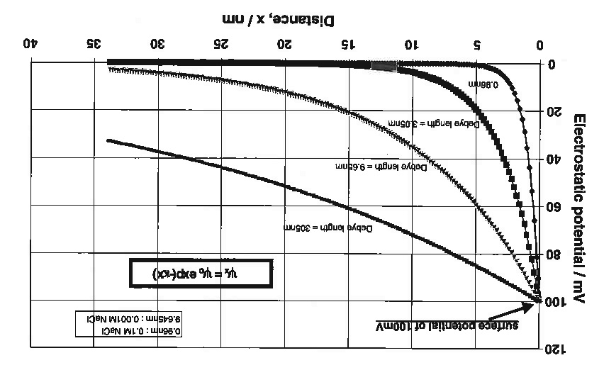

Slide 11
Non-interacting surfaces
x>>κ⁻¹
Interacting Surfaces
x<κ⁻¹
For interacting surfaces we apply the superposition approximation, which means the total potential at point x is given by the sum of the unperturbed potential from each surface
x
x
Ψ=Ψ₀
Ψ=Ψ_{m}
Ψ=0
Ψ=0

